Slide 1
Winlink Basics
Carl Howe, WG1V
wg1v.org

Slide 2
What we'll cover
Why Winlink?
The Winlink workflow model
How to perform basic Winlink functions

Slide 3
What we'll cover
Why Winlink?
The Winlink workflow model
How to perform basic Winlink functions

Slide 4
Why Winlink?
Like it or not, it's a standard for Emergency Communications in the ham radio community
It uses radio and internet links in intelligent ways
It handles standardized messages in ways that efficiently use radio bandwidth

Slide 5
What we'll cover
Why Winlink?
The Winlink workflow model
How to perform basic Winlink functions

Slide 6
Anyone remember these?

Slide 7
The workflow
Create emails offline
Connect to a server to send and receive emails
Read emails offline
Servers redistribute messages

Slide 8
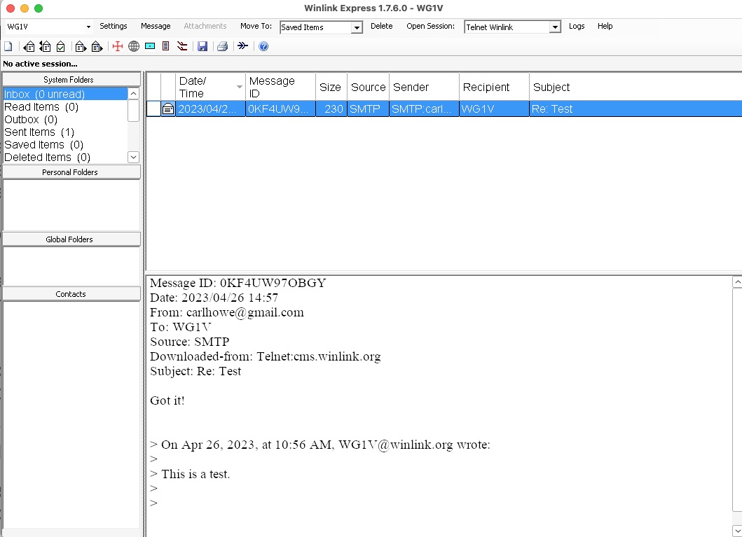
Winlink is just a simple, internet-based email system augmented with radio links

Slide 9
The Winlink workflow
7.100 MHz
7.100 MHz
7.100 MHz
7.100 MHz
Winlink Servers
Ham PC
Internet

Slide 10
1. Create emails offline
7.100 MHz
7.100 MHz
7.100 MHz
7.100 MHz
1
Help!
Winlink Servers
Ham PC
Internet

Slide 11
2. Connect to a server to send and receive emails
2
7.100 MHz
7.100 MHz
7.100 MHz
7.100 MHz
Winlink Servers
Ham PC
Radio transmission modes include ARDOP, VARA, Pactor 3, packet, and many more.
Internet

Slide 12
3. Read emails offline
7.100 MHz
7.100 MHz
7.100 MHz
7.100 MHz
3
Latest
WX
Winlink Servers
Ham PC
Internet

Slide 13
4. Servers redistribute messages
7.100 MHz
7.100 MHz
7.100 MHz
7.100 MHz
3
Winlink Servers
Ham PC
Internet

Slide 14
Requirements for running Winlink
Download the Winlink CMS Software from winlink.org
Register your callsign and password with winlink.org
Whitelist any internet addresses you wish to receive traffic from
Stow and Marlborough ARES setups already have their callsigns and passwords registered

Slide 15
What we'll cover
Why Winlink?
The Winlink workflow model
How to perform basic Winlink functions

Slide 16
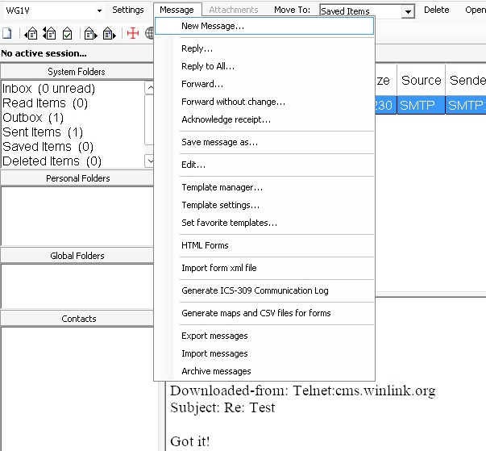
1. Create and Post a Text Email
1
Click on the Message menu on the Winlink home screen
Select New Message from the Message pull-down window
Address your message to callsigns and/or internet addresses
Fill in the message contents
Click Post to Outbox to queue your message for sending.
2

Slide 17
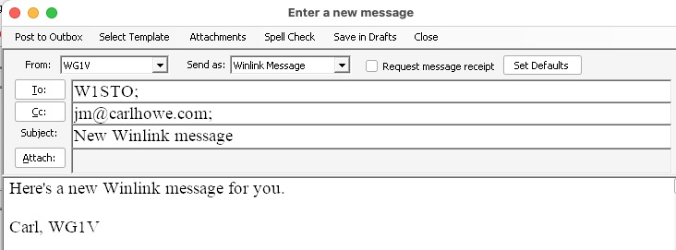
1. Create and Post an Email
Click on the Message menu on the Winlink home screen
Select New Message from the Message pull-down window
Address your message to callsigns and/or internet addresses
Fill in the message contents
Click Post to Outbox to queue your message for sending.
5
3
4

Slide 18
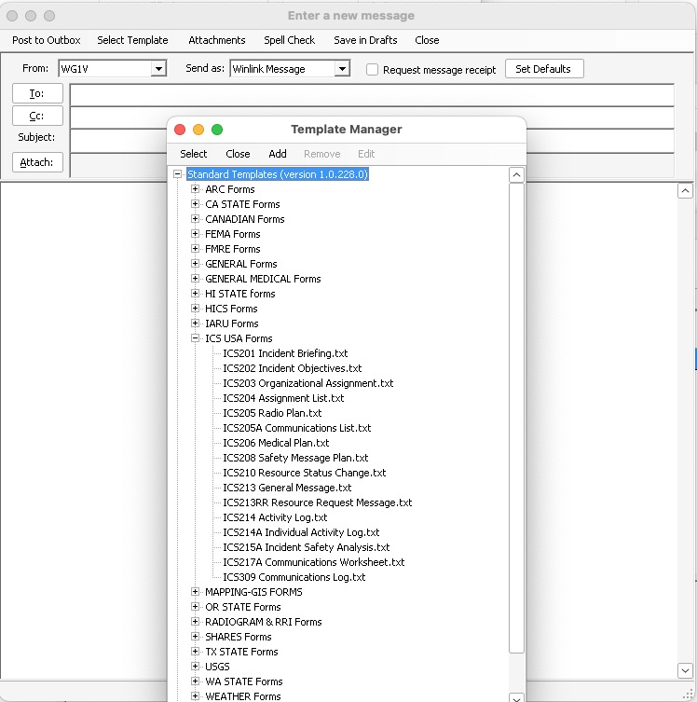
1.1 Create and Post an ICS-213 Form
1
From the New Message window, click on Select Template from the menu bar
Select ICS213 General Message.txt from the list of ICS USA Forms (you may have to click the plus sign to next to ICS USA Forms).
The ICS213 form will open in your web browser. Fill out all the fields and click Submit at the bottom.
With the ICS213 data now in the messaging window, click Post to Outbox
2

Slide 19
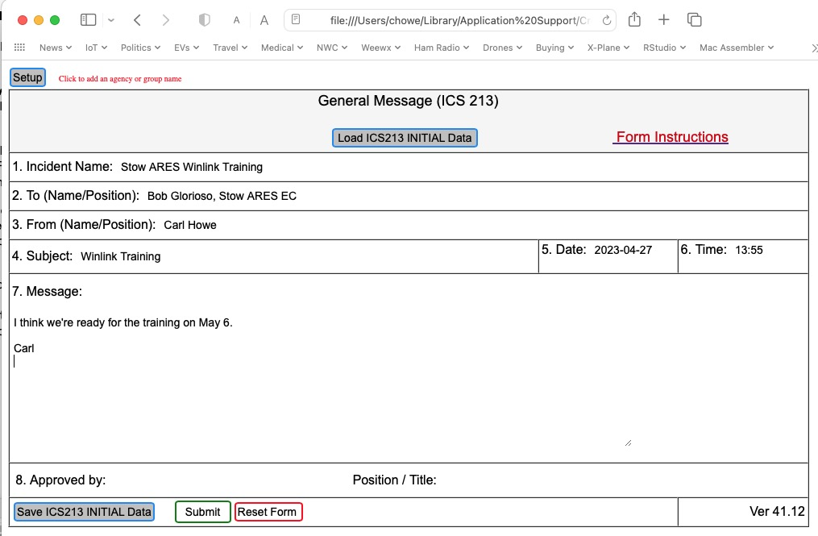
1.1 Create an ICS-213 Form
From the New Message window, click on Select Template from the menu bar
Select ICS213 General Message.txt from the list of ICS USA Forms (you may have to click the plus sign to next to ICS USA Forms).
The ICS213 form will open in your web browser. Fill out all the fields and click Submit at the bottom.
With the ICS213 data now in the messaging window, click Post to Outbox
3

Slide 20
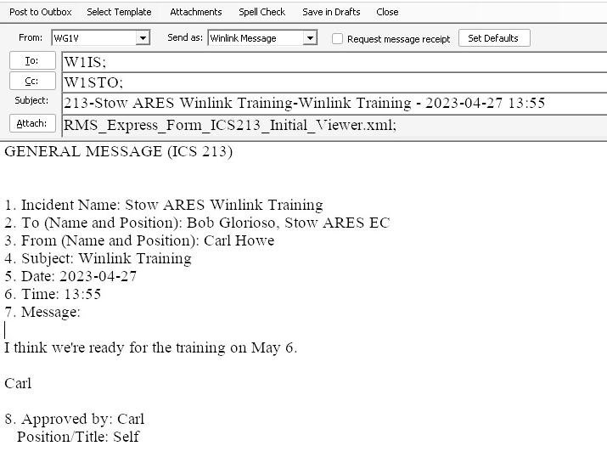
1.1 Create an ICS-213 Form
4
From the New Message window, click on Select Template from the menu bar
Select ICS213 General Message.txt from the list of ICS USA Forms (you may have to click the plus sign to next to ICS USA Forms).
The ICS213 form will open in your web browser. Fill out all the fields and click Submit at the bottom.
With the ICS213 data now in the messaging window, click Post to Outbox

Slide 21
Connecting to a Server

Slide 22
2. Connect to a Server
Connecting to a server requires two separate steps:
Selecting a communications protocol and modem. Possibilities include:
  Telnet over the internet
  VARA modem over HF radio
  ARDOP modem over HF radio
  Packet over VHF radio
  More
Selecting a server that uses that protocol and modem

Slide 23
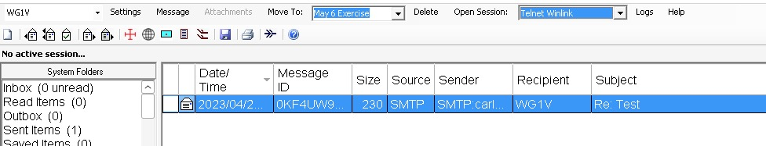
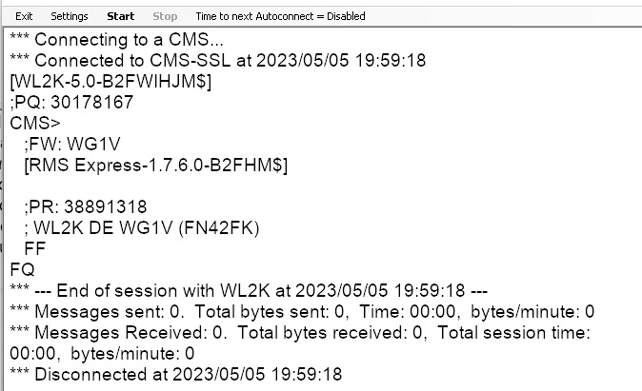
2.1 Connecting using Telnet
2
1
Choose Telnet Winlink from the Open Session pull down menu
Click Open Session
Click Start in the new session window
The great thing about telnet is that you only need an internet connection to use it.
3

Slide 24
2.2 Using Radio Modems
Requires 2 connections
A connection to the audio ports on your radio
A control port to control transmission, push-to-talk, frequency, and mode
Modern rigs such as the Icom IC-7300 combine these two connections into a single USB port.
These connections are already configured at both the Stow and Marlborough fire stations; you should configure them for your specific station according to what you have

Slide 25
3 Steps to a Modem Connection
Launching the session
Choosing a server
Starting the transmission itself

Slide 26
Common Radio Modems
Common modem types:
VARA: a commercial, high-performance, weak-signal modem made by EA5HVK. Versions are available for both HF and VHF. A free version works at reduced speed.
ARDOP: a free and open source HF modem.
Many content management servers support both modem types as well as PACTOR 3, AX.25, and a few others.

Slide 27
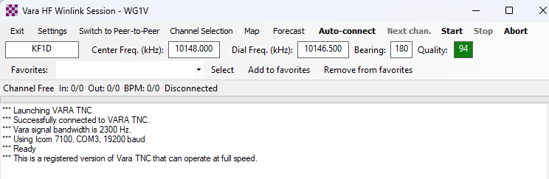
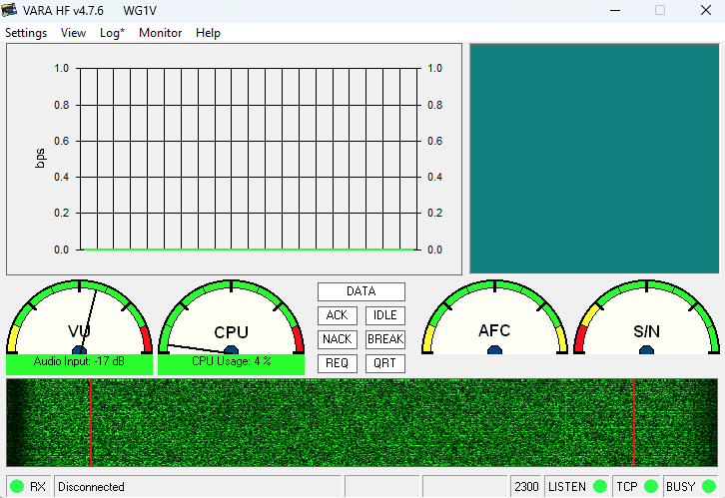
2.3.1 Starting a VARA Session
2
1
Choose Vara HF Winlink from the Open Session pull down menu
Click Open Session
The VARA session and UI windows open
3

Slide 28
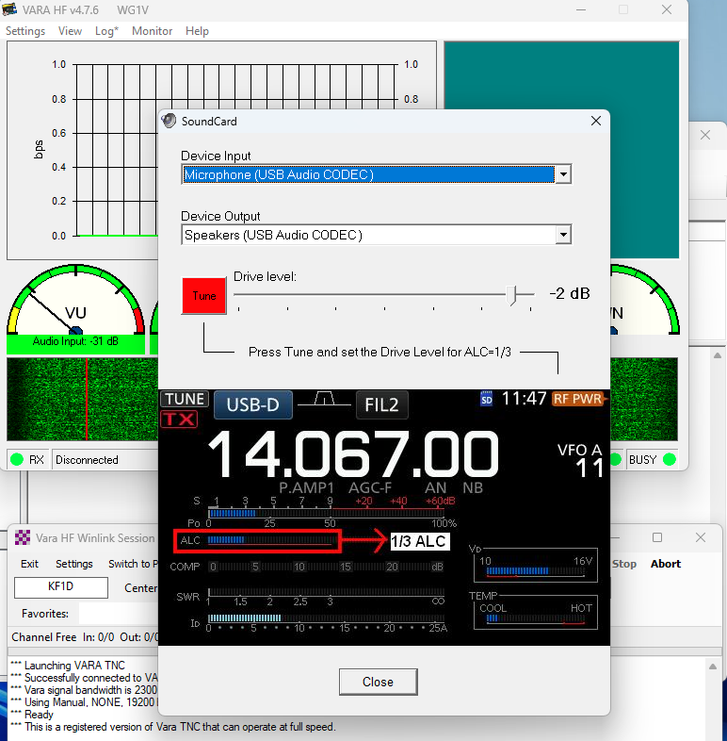
2.3.1 Starting a VARA Session (cont.)
Troubleshooting:
If you don't see the VARA UI window, you may need to click on the VARA icon in the Windows application tray.
If the waterfall shows no signal, you may need to click Settings > Soundcard and select the USB ports for input and output

Slide 29
2.3.2 Ways to Select A Server
Type in the callsign and frequencies into the VARA session window (not recommended, but it can be done)
Select your server from a list of servers provided by VARA
Select your server from a map
PLEASE NOTE: In the process of displaying this window, Winlink may ask if you wish to refresh the server list and path quality estimates. If you are in the middle of an emergency or exercise, YOU DO NOT WANT TO DO THIS. Updating these figures will both require a significant amount of time and internet bandwidth, and you will be unable to do anything until it completes.

Slide 30
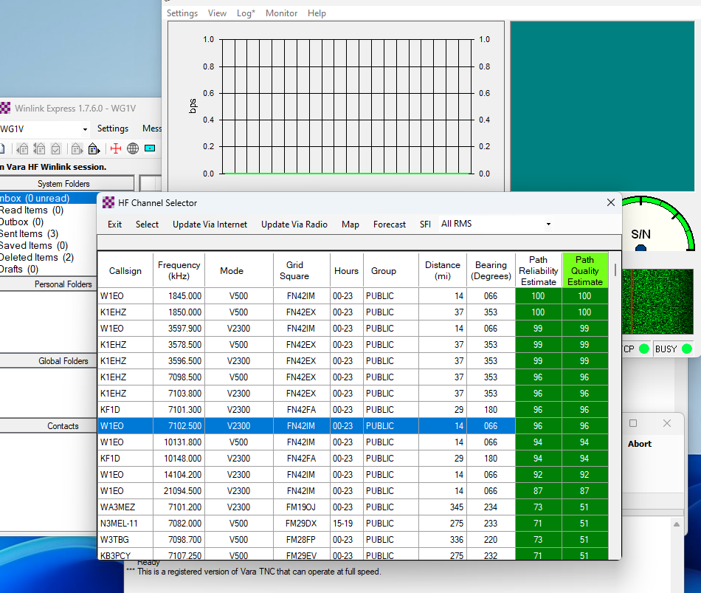
2.3.2 Select a Server from a List
1
Click Channel Selection in the VARA session window
Double-click on the server you want to connect to
2

Slide 32
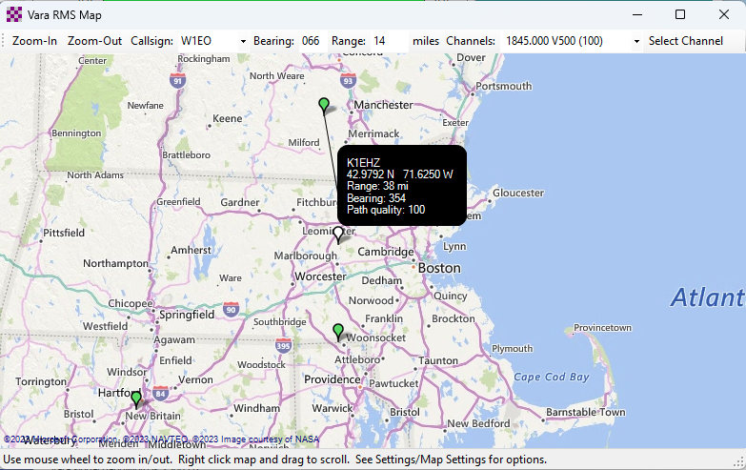
2.3.2 Select a Server from a Map
1
2
Click Map in the VARA session window
Double-click on the green server marker you want to connect to

Slide 33
But What Server Should I Choose?
Choose whatever server you believe will provide the best connection based on current conditions and equipment!
However, In case of an actual emergency where the internet is not available locally, you should choose a server that is outside the area of internet disruption. This is one of the situations where having long-distance HF links can be very important.

Slide 34
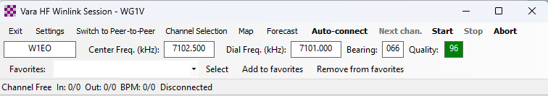
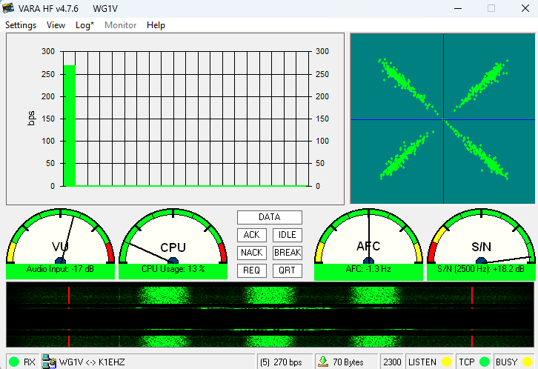
2.3.3 Starting VARA transmission
1
Click Start in the VARA session window.
VARA should begin keying the transmitter with connection requests to the server
The VARA UI screen displays performance metrics once a connection gets made.
The session will eventually time out or complete.
2

Slide 35
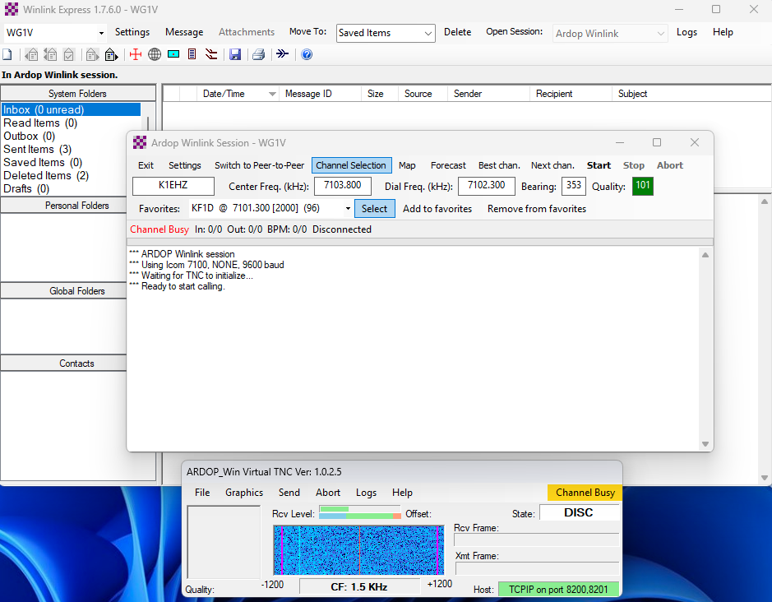
2.3.4 Connecting Using an ARDOP Session
2
1
It's the same sequence as VARA:
Choose ARDOP Winlink from the Open Session pull down menu
Click Open Session
The ARDOP session and UI windows open
Select a server just as we did with VARA
Click Start in the ARDOP session window
4
5
3

Slide 36
Reading Emails

Slide 37
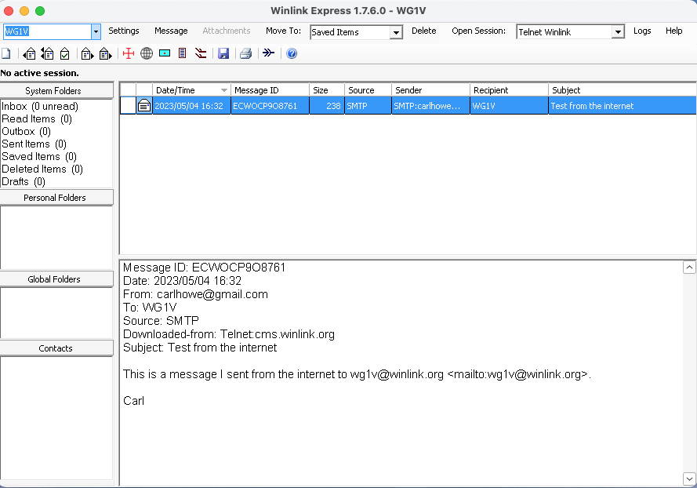
3. Reading Messages
Reading emails works like most common email clients.
New messages appear in your inbox and can be read in the preview pane.
Double-click on a message to show it in a new window.
Opening a formatted message will display it in your browser
1

Slide 38
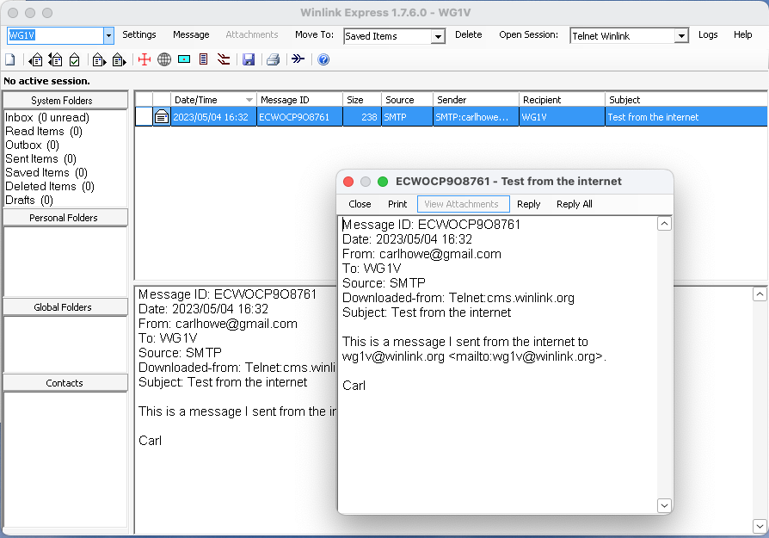
3. Reading Messages
Reading emails works like most common email clients.
New messages appear in your inbox and can be read in the preview pane.
Double-click on a message to show it in a new window.
Double-clicking on a formatted message will display it in your browser
1
2

Slide 39
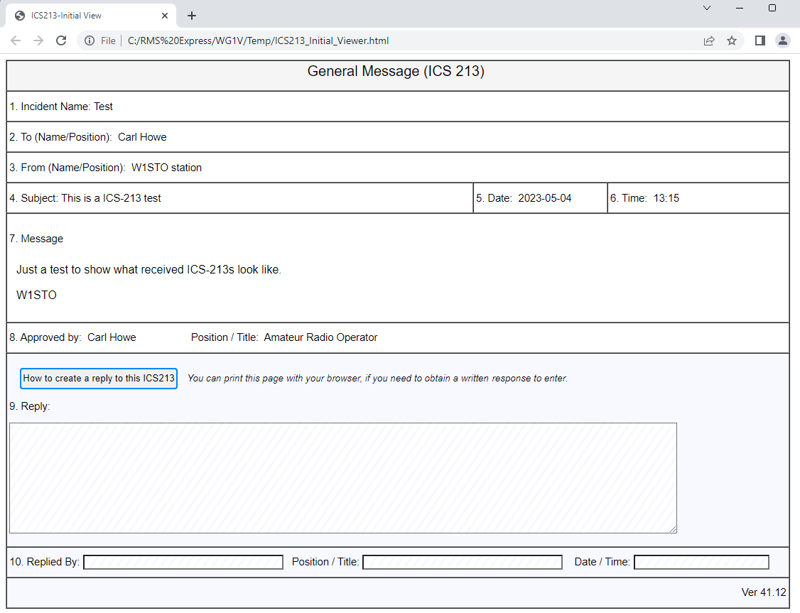
3. Reading Messages
Reading emails works like most common email clients.
New messages appear in your inbox and can be read in the preview pane.
Double-click on a message to show it in a new window.
Double-clicking on a formatted message will display it in your browser
3

Slide 40
But Don't Delete ICS-213s!
Typically ICS-213 messages are used for formal communications with public service and governmental personnel
As such, they should be preserved and not deleted
Best practice is to store them in a folder until they can be archived

Slide 41
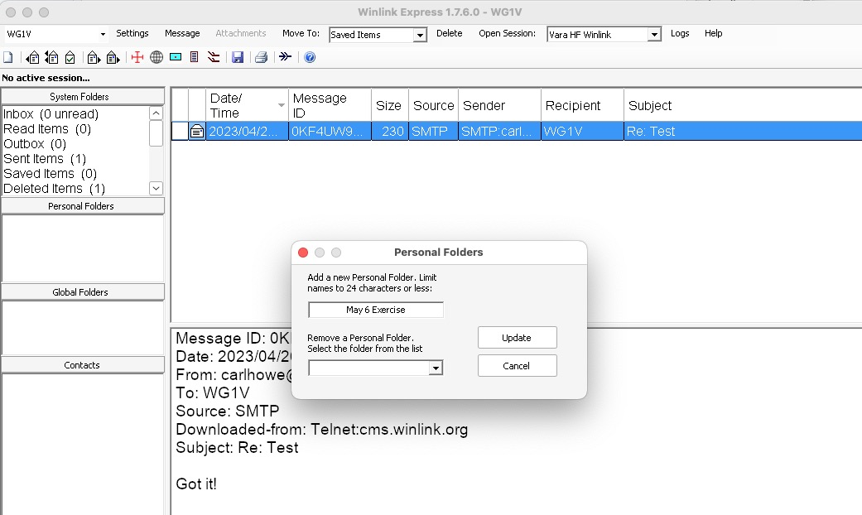
Creating a Folder
Right click in the Personal Folders pane of the main Winlink Express window
Type in the name of the folder you'd like to create and click Update.
1
2

Slide 42
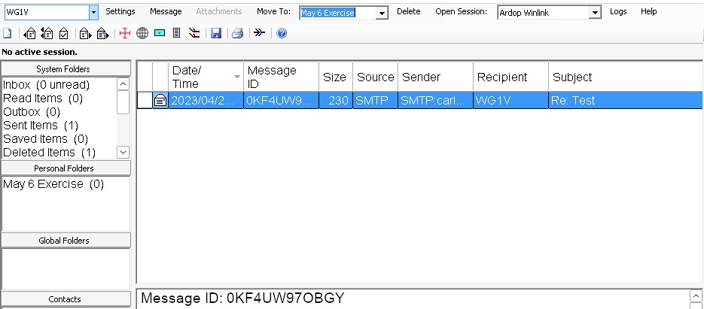
Moving a Message to a Folder
3
2
Highlight the message or messages you wish to move
Select the folder you'd like to move them to.
Click Move To.
1

Slide 43
Winlink Express alternative for Mac users

Slide 44
Why I Don't Use Winlink Express
Winlink Express is:
  Windows PC-only and I run my shack with a Mac mini m1
  Has a monolithic architecture
  Doesn't play well with others
  Predominantly uses a commercial Windows-only modem
The Winlink organization is doing a rewrite that supports Windows, Linux, and Mac, but it isn't expected to be available any time soon

Slide 45
What I Use on My Mac instead of Winlink Express
Pat for reading and sending emails (runs native on the Mac)
rigctld for a rig control server
ARDOP and/or VARA running under Crossover (a Windows-emulation layer)
fldigi, WSJT-X and Rumlog for other digital modes, logging, and contesting
All these programs run simultaneously and can share my radio as needed

Slide 46
Summary
At the end of the day, Winlink is just an offline email client that talks to internet servers using radio. We use it by:
Creating emails offline and posting them to an Outbox
Explicitly connecting to servers to send or receive emails
Reading our emails offline once transmission is complete
Limiting our messages to the essentials

Slide 47
Thank you
This presentation and the narrative paper behind it are available online and in PDF form at http://wg1v.org

